Slide 1
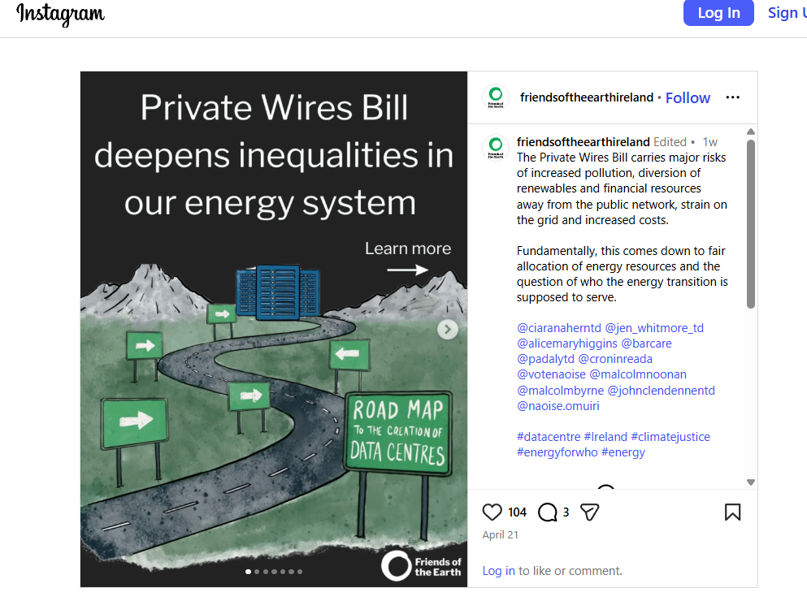
Why we need Private Wires
We want the same outcome as Friends of the Earth.
Cheap, Abundant, Zero Carbon Electricity.
Private Wires / Direct Lines are the fastest way to this outcome, we’ll explain why…

Slide 2
The Electricity Grid Is Under Compounding Pressure
Where the System Is Headed
50%+
11.4%
22%
Projected electricity demand growth to 2030
Wind turned off in RoI in 2025
Wind turned off in Northern Ireland in 2025
Heat pumps, EVs, and data centres add load at locations the grid was not designed to serve.
Curtailed wind does not displace gas. Energy Users pay for both through constraint payments and fuel costs.
Grid connection queues are long; capacity is exhausted in some areas entirely.
Reinforcement timelines of 3–5 years mean electrification demand arrives before the grid can absorb it.
Grid investment cycles run five years - today's decisions shape the 2030s.

Slide 3
What this means for End Users
Higher Electricity Costs
Stressed Carbon Targets
Gas remains the price-setting fuel in more intervals. Curtailed wind does not displace it. Energy Users pay for both.
Offshore delays and curtailment of existing renewables widen the gap between stated ambition and delivered decarbonisation.
Slower Electrification
Lost Opportunity
Grid connection constraints and the absence of hybrid Maximum Export Capacity (MEC) connections mean solar projects, heat pumps, EV chargers, new housing, business expansion and electrification cannot be added at the pace new demand requires.
Without private wires, the full value of renewable electricity cannot flow to the customers who need it and is lost.

Slide 4
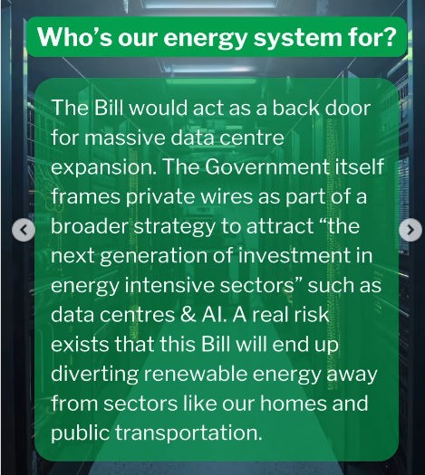
The CRU has published rules for data centres (LEU).
Essentially the need to provide 80% of their power from renewable energy.
They need to provide generation equal or greater than their connection level. Eirgrid will control this generation.
Because the data centre will need to overbuild renewable energy capacity to reach their 80% threshold, excess power during windy/sunny periods will spill to the grid depressing prices during that period.
During cold windless periods when Eirgrid needs power, the data centres will offset very expensive peakers, which will also reduce the high price spikes we currently see. (This is related to Marginal pricing that the Single Electricity Market uses to price electricity).

Slide 5
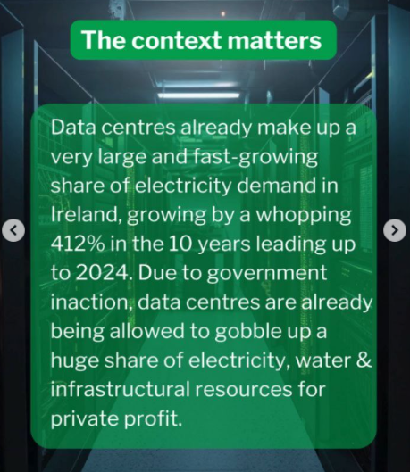
Private wires (Direct Lines) is much more than data centres.
It is illegal for a shopping centre to charge a kiosk for power that they use.
It is illegal for 2 farmhouses miles from the grid to share a solar installation.
It is illegal for a solar farm to provide zero carbon electricity to a neighbouring business park
It is illegal for a housing development to provide (solar + batteries) electricity to new apartment blocks while waiting on a grid connection.
It is illegal for a shopping centre with acres of roof space provide solar electricity to retail tenants.
Energy Saving ISO-50001 and ISO-50100 (decarbonisation) standards explicitly give private wire electricity a higher CSRD score than renewable energy sent over the grid.

Slide 6
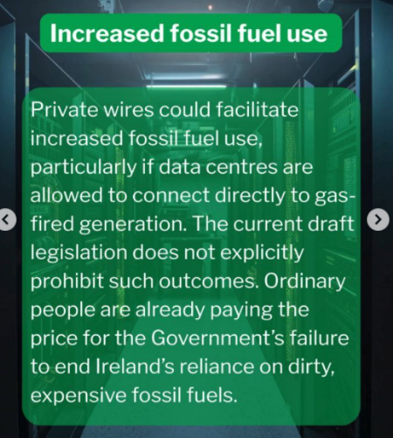
Explicitly ruled out by the CRU Data centre Large Energy User Rules.
The deep pockets of the data centre industry will be tapped to develop more renewable projects, and provide backup generation dispatchable by the grid offsetting very expensive peakers.

Slide 7
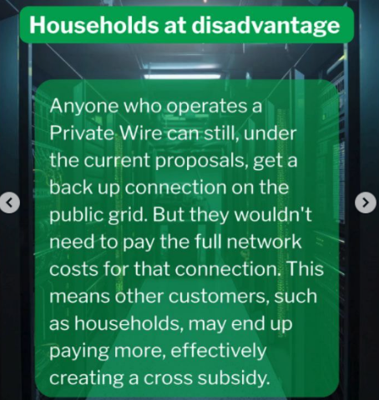
The opposite is true.
Network costs are made up by a fixed element – relating to the size of the connection needed. An operator will pay the full cost of the connection.
There are also costs relating to the number of kWh units used.
The CRU has powers to levy private wires as it sees fit.
More renewables on the Grid help to break the relationship between gas and electricity prices and will drive prices down. (The Grid uses Marginal Pricing to set the electricity price in every hour).

Slide 8
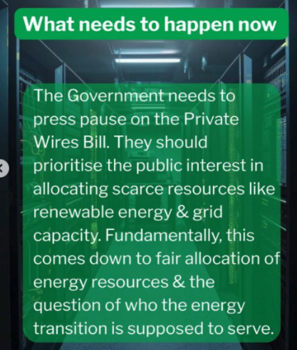
The opposite is true.
Ireland is currently a petro-state, 80% of our energy is imported.
By denying private wires, it keeps the status quo in operation.
We need ABUNDANT, Cheap, Zero Carbon Electricity.
Private Wires, The North South Interconnector, DASSA (Day ahead System Services Auction), Batteries allowed to Export Power are complimentary ways to achieve this important goal.
Help Ireland transition to an Electro-state.

Slide 9
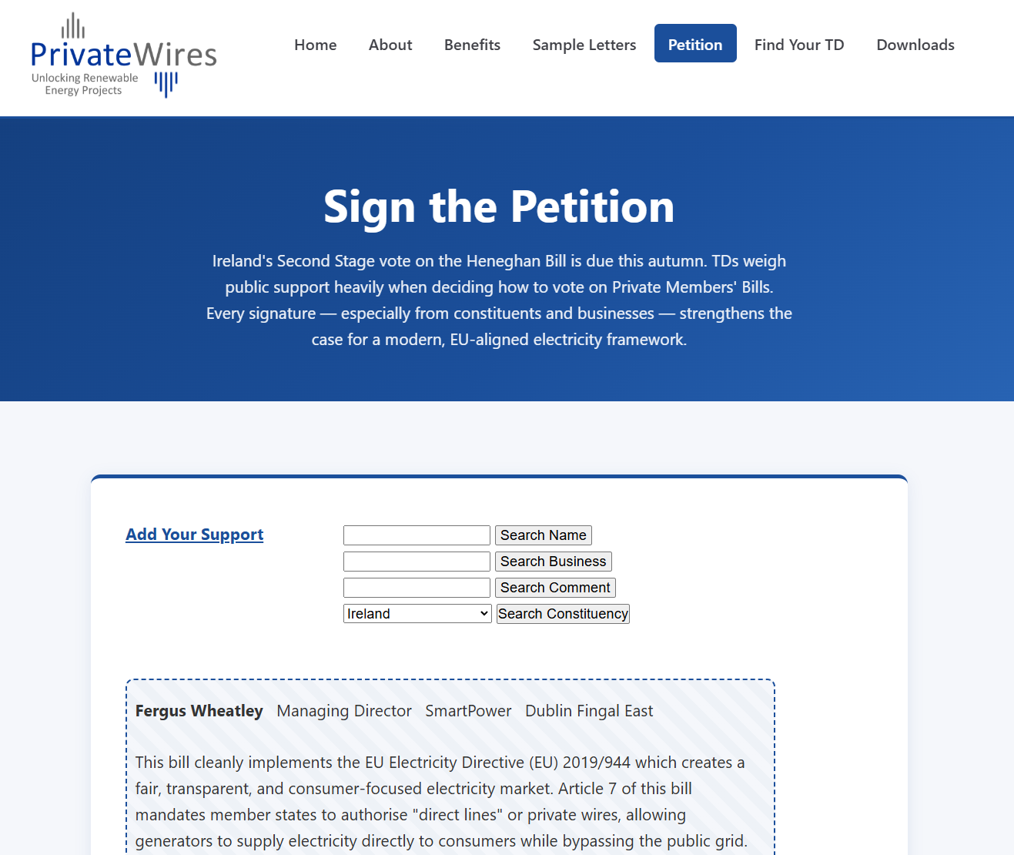
www.privatewires.ie

