Slide 1

Private Wires
A fantastic opportunity for industry. But we need your help.
Fergus Wheatley – SmartPower 086-3807914.

Slide 2
The Electricity Grid Is Under Compounding Pressure
Where the System Is Headed
50%+
11.4%
22%
Projected electricity demand growth to 2030
Wind turned off in RoI in 2025
Wind turned off in Northern Ireland in 2025
Heat pumps, EVs, and data centres add load at locations the grid was not designed to serve.
Curtailed wind does not displace gas. Energy Users pay for both through constraint payments and fuel costs.
Grid connection queues are long; capacity is exhausted in some areas entirely.
Reinforcement timelines of 3–5 years mean electrification demand arrives before the grid can absorb it.
Grid investment cycles run five years - today's decisions shape the 2030s.

Slide 3
What this means for End Users
Higher Electricity Costs
Stressed Carbon Targets
Gas remains the price-setting fuel in more intervals. Curtailed wind does not displace it. Energy Users pay for both.
Offshore delays and curtailment of existing renewables widen the gap between stated ambition and delivered decarbonisation.
Slower Electrification
Lost Opportunity
Grid connection constraints and the absence of hybrid Maximum Export Capacity (MEC) connections mean solar projects, heat pumps, EV chargers, new housing, business expansion and electrification cannot be added at the pace new demand requires.
Without private wires, the full value of renewable electricity cannot flow to the customers who need it and is lost.

Slide 4
02
Current Legislation
The 1999 Act is a set of handcuffs on the Renewables Industry.
Fergus Wheatley – SmartPower 086-3807914.

Slide 5
Arthur Cox – briefing paper – Catches the essence
The following is an extract from an Arthur Cox Briefing paper that explains the Irish situation very well. (Red text is added)
What is the Irish position?
In transposing EU law, Ireland has implemented the Article 7(4) option. The Commission for Regulation of Utilities (“CRU”) will not grant a direct line permission unless a person has applied for connection to the grid and, either the application has been refused because of lack of capacity, or a dispute has been referred to the CRU and the CRU forms the view that it is in the public interest to issue the direct line permission.
What happens in practice?
Applications to connect to the grid tend to be queued up rather than refused outright. In a more recent and worrisome development, in December 2021 the CRU directed EirGrid to treat certain applications from data centres as being ‘terminated’ rather than refusing them. This in each case means that the conditions that would allow the CRU to grant a direct line permission are not being triggered in, we would argue, precisely the circumstances in which the Directive intends that direct line consents should be available.
This is problematic for industry participants and large business customers given that a failure to accept or refuse a grid connection agreement within a reasonable timeframe frustrates the obligation on Ireland under Article 7(1) of the European DIRECTIVE (EU) 2019/944.
The requirement under the Renewable Energy Directive II that the permit-granting process should not exceed two years should assist, if it were complied with, even if the outcome of a permit-granting process is a refusal to offer a connection.

Slide 6
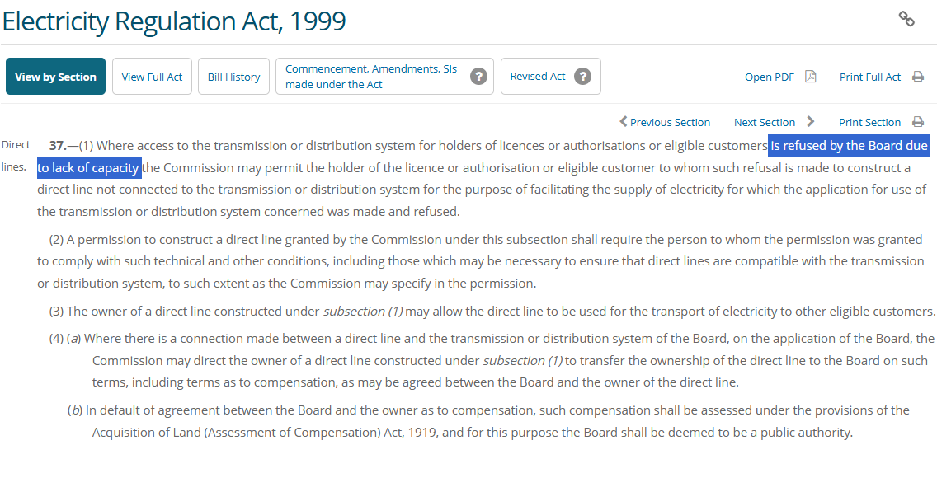

Slide 7
European DIRECTIVE (EU) 2019/944
https://eur-lex.europa.eu/legal-content/EN/TXT/?uri=CELEX%3A02019L0944-20240716
Direct lines — Article 7
1. Member States shall take the measures necessary to enable:
(a) all producers and electricity supply undertakings established within their territory to supply their own premises, subsidiaries and customers through a direct line, without being subject to disproportionate administrative procedures or costs;
(b) all customers within their territory, individually or jointly, to be supplied through a direct line by producers and electricity supply undertakings.
2. Member States shall lay down the criteria for the grant of authorisations for the construction of direct lines in their territory. Those criteria shall be objective and non-discriminatory. (This Clause is why the HENEGHAN BILL passes all private wires oversight to the CRU).
3. The possibility of supplying electricity through a direct line as referred to in paragraph 1 of this Article shall not affect the possibility of contracting electricity in accordance with Article 6.
4. Member States may issue authorisations to construct a direct line, subject either to the refusal of system access on the basis, as appropriate, of Article 6 or to the opening of a dispute settlement procedure under Article 60.
5. Member States may refuse to authorise a direct line if the granting of such an authorisation would obstruct the application of the provisions on public service obligations in Article 9. Duly substantiated reasons shall be given for such a refusal.

Slide 8
03
Competing Bills – both address Private Wires
Comparison of Heneghan’s Private Members Bill v Government Scheme for Private Wires.
Fergus Wheatley – SmartPower 086-3807914.

Slide 9
Government Scheme for Private Wires
What the scheme allows
Essentially the bill provides for the build out of Private Wires in the following circumstances:
to permit a private wire linking a single user of electricity (such as a data centre) to a separate generation asset (such as a wind or solar farm). Such a connection may also include storage technologies;
to facilitate hybrid grid connections. This involves a wind or solar farm, which is owned by one company, sharing a grid connection with another generation or battery installation that is owned by another firm;
to allow on-street charging solutions for Electric Vehicles (EVs); and
to allow a customer that self-supplies electricity to provide electricity to a separate customer in a contiguous premises.
Governance & next steps
The CRU will be responsible for Safety and Licensing and the Minister is required to undertake a 10 year review.
https://www.gov.ie/en/department-of-climate-energy-and-the-environment/publications/private-wires-policy-statement/
What happens next?
There are 47 recommendations from the Government Report on Pre-Legislative Scrutiny (PLS) of the Private Wires Bill 2025. Some of these recommendations are at odds with “Those criteria shall be objective and non-discriminatory.” in the EU directive 2019/944 (Article 7). Indeed, the Directive opens up the possibility of a legal challenge from an entity not included in the named circumstances. In our view there is at least a year needed to reach an acceptable draft.

Slide 10
Heneghan’s Private Member’s Bill — Private Wires
What the bill does
Heneghan’s bill simply removes the stipulation that ESB Networks MUST turn down a connection on grounds of capacity before the CRU can sign off on an electrical connection between two private parties (Section 37 of the 1999 Electricity Regulation Act).
It gives the CRU powers to regulate this area regardless of connection size — for example, deeming certain classes of connection automatically approved (EV charging connections, solar projects feeding two or more private parties). The CRU will be responsible for Safety and Licensing.
The CRU is already in charge of electrical safety and regulates renewable energy requirements (for example, an 80% renewable energy requirement for data centres), so it is uniquely well placed to regulate this important area.
Status & compatibility
The bill has been formally introduced to the Dáil (including sign off by the Office of Parliamentary Legal Advisers -OPLA) and is now in the public domain.
https://data.oireachtas.ie/ie/oireachtas/bill/2026/68/eng/initiated/b6826d.pdf
Most importantly, the bill is compatible with “Those criteria shall be objective and non-discriminatory.” in the EU directive 2019/944 (Article 7) — and indeed the entire directive.
It also answers all 47 recommendations from the Government Report on Pre-Legislative Scrutiny (PLS) of the Private Wires Bill 2025.
(The 47 recommendations as they relate to the Heneghan bill are discussed in detail in a separate document).

Slide 11
What Happens Next?
A Private Members’ Bill moves through three parliamentary stages before it becomes law.
1
2
3
Second Reading/Second Stage
Committee Stage
Final Vote & Law
The general principles and purpose of the bill are debated in the Dáil, then members vote on whether to formally allow the bill to proceed to the committee stage.
If the bill passes the second reading, it is scrutinised in detail by a parliamentary committee.
The bill then faces a final vote before being (hopefully) passed into law.
ESTIMATED TIMELINE Around 6 months from now (hopefully). But we need your help.

Slide 12
Why this is important for Ireland Inc.
EIRGRID TRANSMISSION DEVELOPMENT PLAN 2012–2022
€3bn
“There is a further 13.3 GW of wind generation and 9.5 GW of other types of generation in the applications queue.”
per year — conservative value to the Irish economy
This is a 2012 figure taken from an Eirgrid report footnote and the last published figure we could find. Considering the cost reductions in Wind, Solar and Batteries in the interim, 20 GW would be the very minimum frustrated connection demand. Given that the entire grid is only 10GW (€7 billion per year), ESB Networks cannot remotely cope with this level of demand. Assuming these projects (or equivalents) are built using private wires, and the capacity factor averages 25% (rough figures between solar & wind), we are looking at a conservative value to the Irish economy of €3 billion per year. With the side benefit of significant reductions of fossil fuel imports.
Benefits include
Removes a roadblock to building out many thousands of small renewable projects.
Facilities with excess solar generation can sell power directly to third parties.
Apartment blocks and estates can energise while awaiting a grid connection.
Simplifies building Part L compliance and industry with ISO-50100 certification.
Opportunities for renewable developers to connect multiple users in a business park to cheaper power.
Only realistic / timely way to connect offshore wind farms.

Slide 13
Addressing Concerns
The common objections to the bill — and why each one falls away on closer inspection.
Would this breach EU law?
No. It is a clean straightforward implementation of the EU Directive (EU) 2019/944 which establishes common rules for the internal electricity market, focusing on consumer rights, market integration, and the transition to a sustainable energy system.
Who guarantees safety?
The CRU takes responsibility for safety and licensing across all connection sizes.
Will it result in lots of new pylons?
No. Connections will nearly always be peer to peer at low voltage. The vast bulk of connection will be underground or between contiguous premises. By taking pressure off the grid, private wires will reduce the number of pylons needed.
Is it being rushed?
No. The Office of Parliamentary Legal Advisers (OPLA) spent 18 months researching and writing the bill. It answers all 47 Pre-Legislative Scrutiny recommendations of the Government Scheme and follows the Dáil’s normal stages.
Are small local systems prioritised?
Yes. Certain types of systems (EV charging connections / Small Solar) may be deemed by the commission as automatically permitted. Project licensing relies on objective criteria open to any user, from apartment blocks to small/large businesses, farms and homeowners.
Do data centres get first call?
No. The CRU takes responsibility for licensing. By virtue of simplicity, Private Wires would likely first unlock the many thousands of small and community renewable projects. Data Centres already have a higher level of scrutiny, which must take climate into account.
Does it shift costs onto households?
No. Projects are 100% privately funded and connect users directly, easing demand on the shared network. It reduces grid congestion and reduces the "pay twice" grid costs. More renewables, means less demands on power stations and the grid, hence lower prices.
Does it weaken network planning?
No. The CRU keeps coordinating and licensing every connection within the wider grid plan.
A register of all private wire connections will be kept by the CRU.
Does it undermine climate targets?
No. It helps achieve them by enabling many thousands of small renewable projects and off-shore wind.

Slide 14
IF THE BILL FAILS
WHAT WE ASK OF YOU
Should the Heneghan bill not pass its second reading, the Government Scheme would become the sole path to Private Wire legalisation. As that scheme is less fully developed, additional delays would follow.
Help ensure that TDs across the country are informed of the benefits of a quick passage of the Heneghan bill. Use any platform and relationships you have to support its second reading.
Thank you
Fergus Wheatley – SmartPower 086-3807914.

Slide 15
About SmartPower
Grants for Energy Saving Projects
ISO-50001, I.S. 399. Energy Management
Extensive experience working with the SEAI on their Excellence in Energy Efficiency Design (EXEED) program. This program is lengthy but has the best grant levels. Experience with nearly all the various local authority, SEAI and Enterprise Ireland grant programmes.
ISO-50001, Design for Energy Management. Active member of NSAI ISO/Technical Committee 59 (Energy Management and Energy Savings).
Energy Audits, Submetering, ISO-50001 Monthly Reports.
Energy Credit Rebates
Hedging and Buying Energy
Registered International Performance Measurement and Verification Protocol (IPMVP) professional, calculating energy savings for Energy Efficiency Obligation Scheme (ESOS) energy credits. (Some projects get more credit rebates than the project CAPEX).
Cost-effective procurement for both electricity and gas. Market advice on how and when to hedge forward or follow the Day Ahead Market. Our software reverse-engineers energy invoices to give detailed mark-up analysis and monthly budget figures.

